Slide 1
BRAIN WAVE CONTROLLED ROBOT
BY:
RUTH BALAJI (39130382)
SUBHARAJA CHELLAM.A (39130443)
SNEHA.S (39130434)
DEVADHARSHINI (39130108)

Slide 2
OVER VIEW
ABSTRACT
OBJECTIVE
NEED FOR PROJECT
LITERATURE SURVEY
MOTIVATION
METHODOLOGY
NEURO VIEW
FINAL EEG WAVE FROM BRAIN WAVE SENSOR
PHOTOS OF BCR
CONCLUSION
FUTURE SCOPE
REFERENCES

Slide 3
ABSTRACT
Paralysis is a persistent vegetative state of a human being or a few motor organs of him for a long or short period of time. Patients who are paralyzed still exhibit Electro Encephalogram (EEG) patterns indicating brain activity. In this project ‘Mind Controlled Robot’ has been proposed for supporting paraplegics, quadriplegics, people affected in accidents relying on other people even to move from one place to another. This robot is capable to move and to change direction of wheelchair based on attention level and meditation level of mind and to control home appliances like light , fan through eye blinks The proposed work uses a NeuroSky biosensor as the Brain Computer Interface. The sensor data is used to control a robot possibly a motorized wheelchair. There by a paralysed person with no or partial muscular activity can independently move without depending upon anyone.

Slide 4
OBJECTIVE
To aid quadriplegics, paraplegics, people involved in freak accidents and people with motor conditions severe enough to impair movement of the extremities, it will give them an alternative way of controlling traditional wheelchairs.
To develop a miniature wheelchair prototype that is controlled via the user’s blinks and brainwave data.
To develop an MATLAB Code that will serve as a data receptor for the Mind wave Mobile and a data transmitter for the miniature wheelchair.

Slide 5
NEED FOR THE PROJECT
There were 1179 963 disabled individuals in Tamil Nadu in 2011, a disability rate of 1635 per 100 000 population.
Sixteen districts had disability rates above the state average. As age advanced, disability rates increased; the highest disability rate of 2533 per 100 000 was among people aged 60 years and above.
Rural areas had higher disability areas compared to urban
Disability rate in the Scheduled Castes was higher at 1763 per 100 000 compared to the Scheduled Tribes and other social groups.
Multiple disability was high in the age groups 0-19 years and 60 years and above. To support them this project was chosen.

Slide 6
LITERATURE SURVEY
Bluetooth Remote-Controlled Car(Hector Dominguez/2014)
• Uses PWM signals to drive the DC motors.
•The features include the ability to move forward, backwards, left and right.
Drawback: The car can only be controlled only if the connectivity is with a certain range
Android-controlled monitoring toy car via WIFI(Rosevir Ceballos/2014)
•It is an car with an camera and a router mounted on it that can be controlled through an Android Smartphone application.
•The IP camera also features night vision and the ability to be panned through the Android application.
Drawback: The lead acid battery used to power the car could only power the system for short period of time before requiring to be charged again.

Slide 7
Controlling electrical devices with human brainwaves(Stanacevic/2015)
•The Raw brainwave data are fed into the Mind wave Mobile and put through a series of processing algorithms to make it suitable for microcontroller use.
• The Mind wave Mobile’s accuracy in terms of translating brainwave data into usable ones.
Drawbacks:
• Did not use other features of the Mind wave Mobile such as blink detection.
• The transmission range of Bluetooth is limited.
• Range of brainwave-related data is also limited.
Mobile-controlled wheelchair(Roger Achkar/2016) :
• Auto-movement of electric wheelchair.
•It can save a pre-defined path for the wheelchair to take.
Drawbacks:
•The lack of an obstacle-sensing feature.
•Handicapped people with no limbs have no way of using the wheelchair as it requires them to use a Smartphone to control it.

Slide 8
Biomedical Applications(Jobby K.Chacko/2017):
• It uses BCI technology.
• It is Time and Cost efficient.
Drawbacks: They didn’t address atypical brain responses which can be the result of illnesses such as stroke.
Gaming(Atanasios Vourvopoulos /2017):
•Gaming uses BCIs for movement.
•Also used to control difficulty level in multiplayer games, by triggering Dynamic Difficulty Adjustment (DDA), which increases difficulty for strong players and decreases difficulty for weaker players.
Drawbacks: Algorithms is Sensor based that cause significant problems when building such systems.

Slide 9
MOTIVATION
The design and functionality of wheelchairs have improved with the invention of the first lightweight, collapsible and mass-produced wheelchair in 1933 by Harry Jennings and Herbert Everest serving as the introduction of the modern-day wheelchair.
In addition to the traditional manpower-driven wheelchairs, electric and battery-powered wheelchairs are now also available.
Up until the last few years, electroencephalography has for the most part only been available in hospitals and other medical institutions where, using this technology wheelchairs can also be controlled even by Physically retarded people.

Slide 10
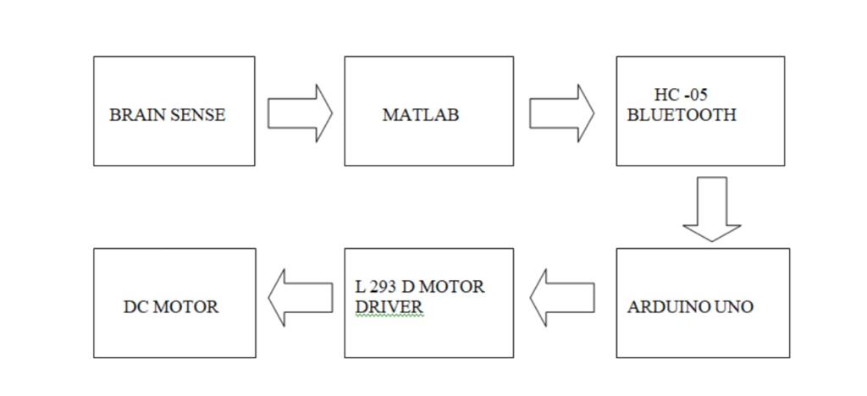
METHODOLOGY

Slide 11
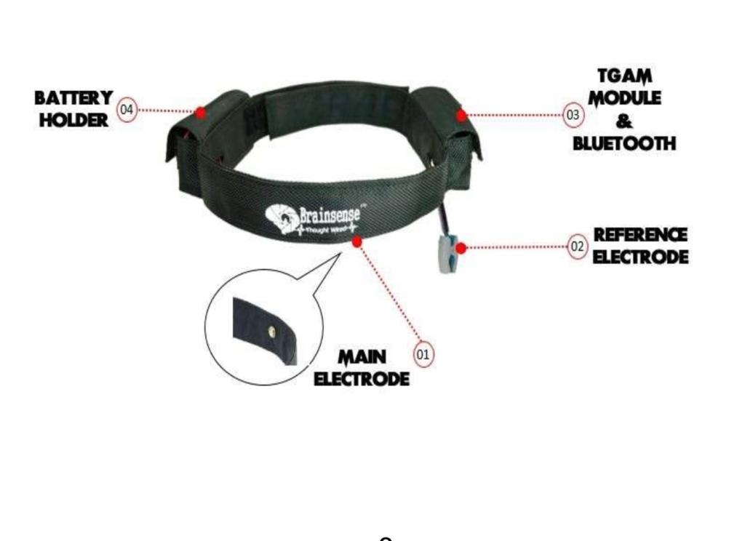
BRAINSENSE
The device that works under the Principle of BCI - Brain-Computer Interface.
It analyzing brain with EEG – Electroencephalography.
Electrodes can be just placed in the scalp of the brain, instead of injecting the electrode into the brain tissues and also it is a dry electrode, which doesn’t require any gel before use.

Slide 12
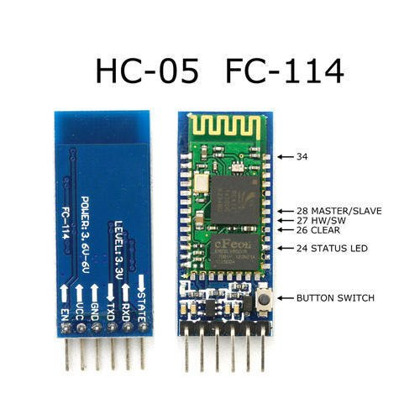
HC-05 BLUETOOTH MODULE
The HC-05 is a MASTER/SLAVE module.
The slave modules cannot initiate a connection to another Bluetooth device ,Master module can initiate a connection to other devices.

Slide 13
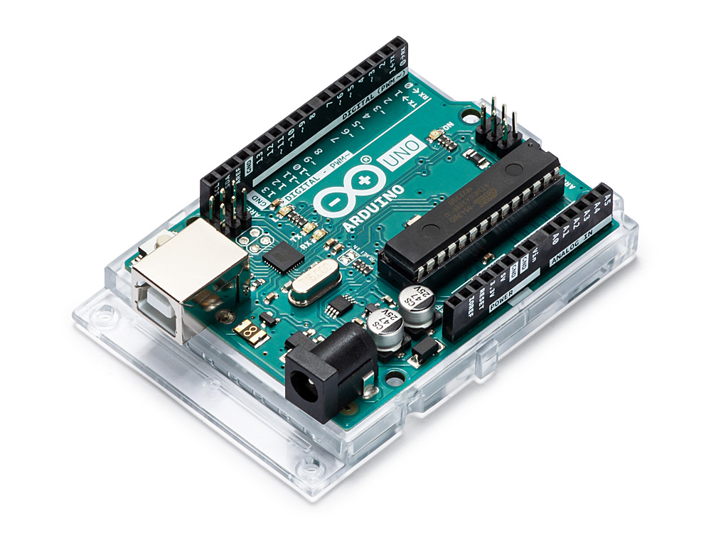
ARDUINO UNO
Arduino Uno is a microcontroller board. It has 14 digital input/output pins (of which 6 can be used as PWM outputs).

Slide 14
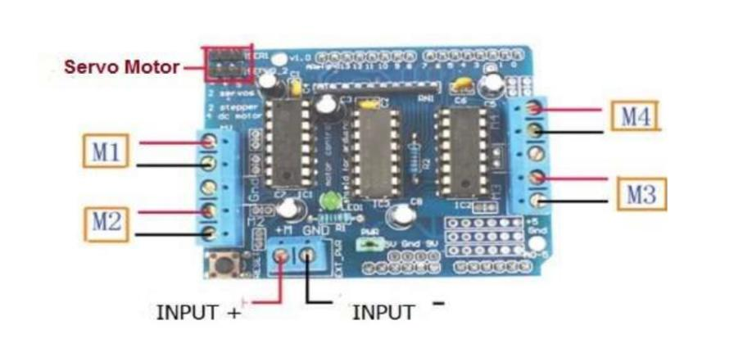
L293D MOTOR DRIVER
L293d is a typical Motor driver or Motor Driver IC which allows DC motor to drive on either direction.
In a single L293d chip there are two h-Bridge circuit inside the IC which can rotate two dc motor independently.

Slide 15
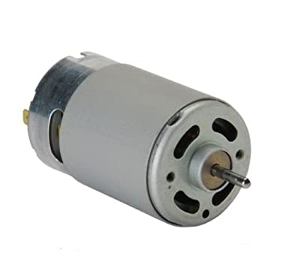
DC MOTOR
A DC motor converts direct current electrical energy into mechanical energy.
DC motor used is an 12V with 150 RPM.

Slide 16
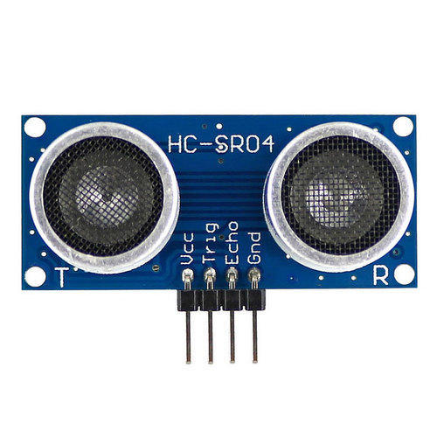
ULTRASONIC TRANSDUCER
The ultrasonic sensor are devices that generate or sense Ultrasound energy.
They also evaluate targets by interpreting the reflected signals.
The detection range of the sensor is about 70 feet.

Slide 17
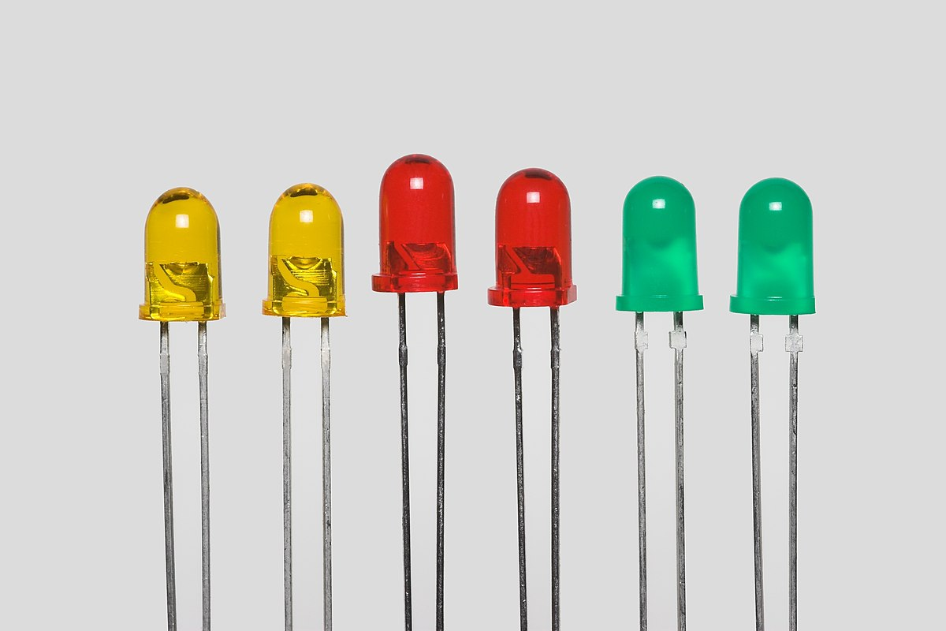
LED
It is a semiconductor light source that emits light when current flows through it.
The color of light is determined by the energy required by electrons to cross the band gap of semi conductor.

Slide 18
NEURO VIEW
The software that helps in displaying the live recording brain waves which is been sensed from the silver chloride electrode.
Initially the electrode must be placed on the forehead and it begins to read the brain waves these waves are transmitted to the Neuro view via Bluetooth.
For activation or reading the Brain wave first we have to set the baud rate to 57600 and select the appropriate COM port where the Brain sense and Neuro view are connected.
Once they are connected the Brain waves will start to be displayed and it is flowing in an low amplitude waveform.
If we blink then the signal starts to increase in amplitude and with this amplitude change due to blink level we can drive the motor using MATLAB software.

Slide 19
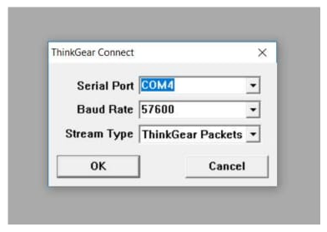
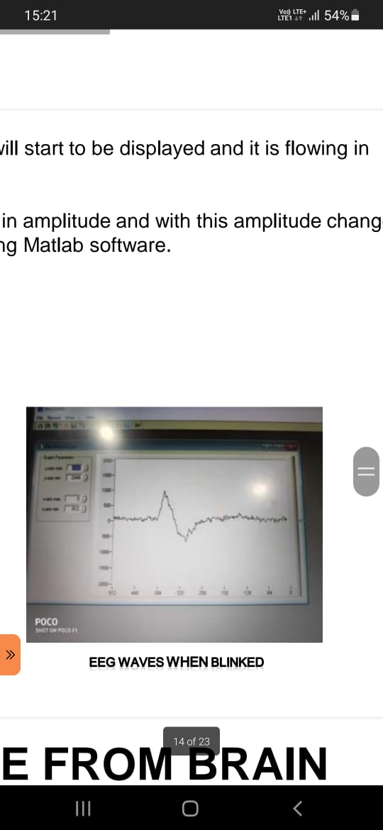
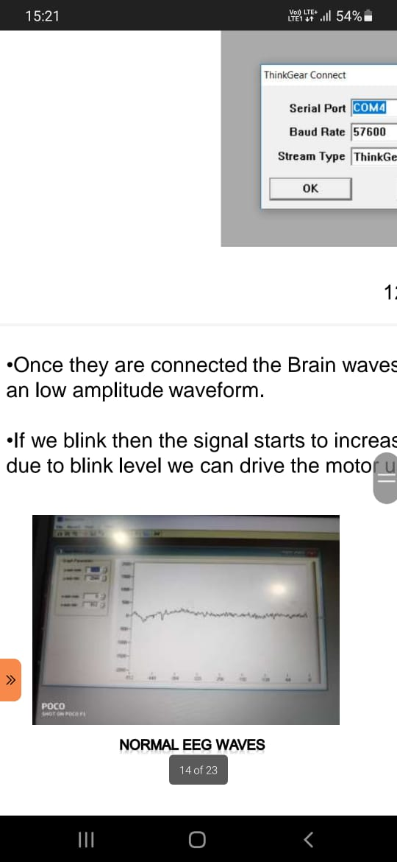

Slide 20
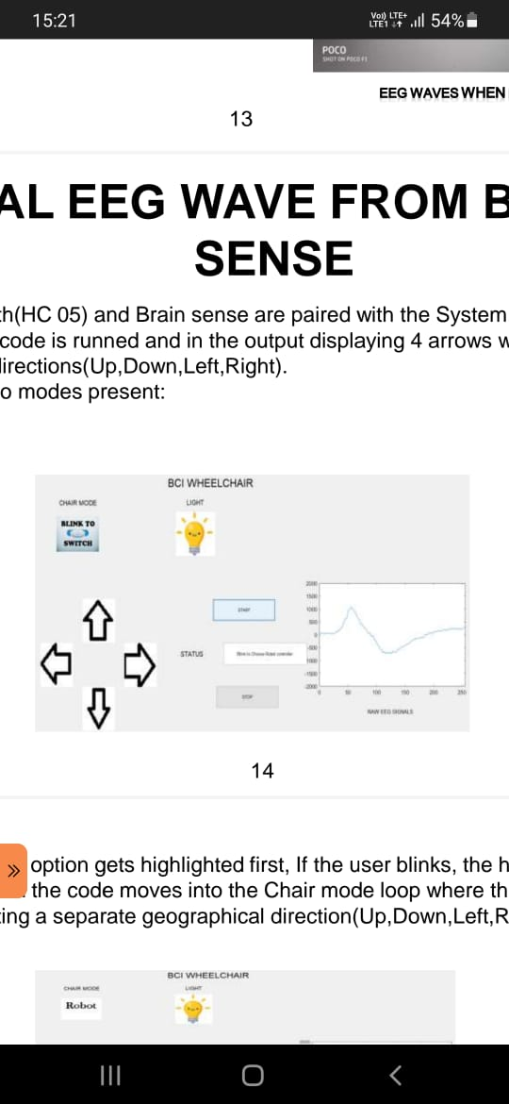
FINAL EEG WAVE FROM BRAIN SENSE
The Bluetooth(HC 05) and Brain sense are paired with the System.
The Mat lab code is runned and in the output displaying 4 arrows where each arrow denotes the directions(Up, Down, Left, Right).
There are two modes present:
• Chair mode
• Light mode

Slide 21
Chair Mode:
• The Chair Mode option gets highlighted first, If the user blinks, the highlighted option gets selected and the code moves into the Chair mode loop where there are four arrows each representing a separate geographical direction(Up,Down,Left,Right).
•Initially the North facing arrow gets highlighted first and if there is no activity from the user then the East facing arrow gets highlighted and if there is still no activity from the user the south facing arrow gets highlighted and so on. This gap between each arrow getting highlighted is about 0.5 seconds.
•Once the North facing arrow gets highlighted and if the user blinks, the EEG signal is read and displayed on the Raw EEG signal column and the car moves in the Forward direction (North).The same procedure is followed for the remaining directions.

Slide 22
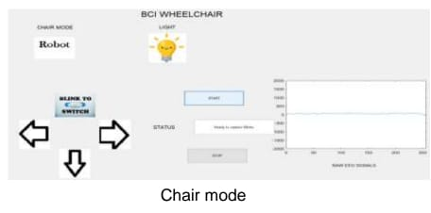

Slide 23
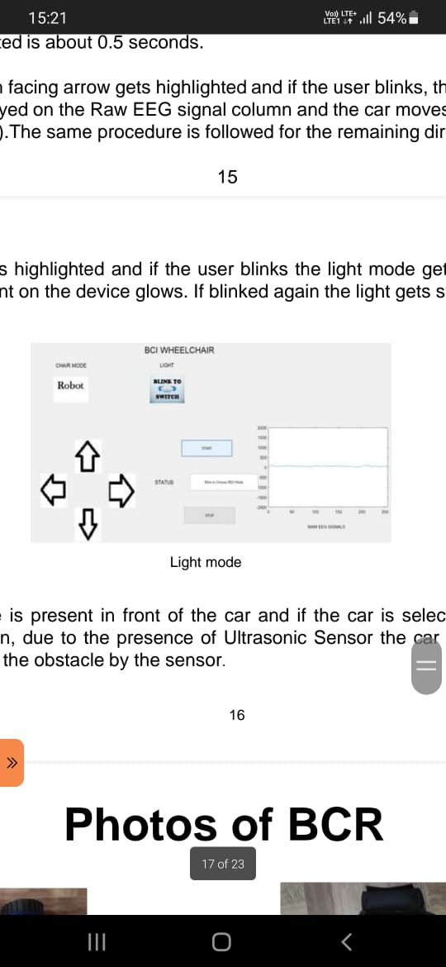
Light Mode :
•If Light mode is highlighted and if the user blinks the light mode gets selected and the LED light present on the device glows. If blinked again the light gets switched off.
•If any obstacle is present in front of the car and if the car is selected to move in the forward direction, due to the presence of Ultrasonic Sensor the car won’t move due to the detection of the obstacle by the sensor.

Slide 24
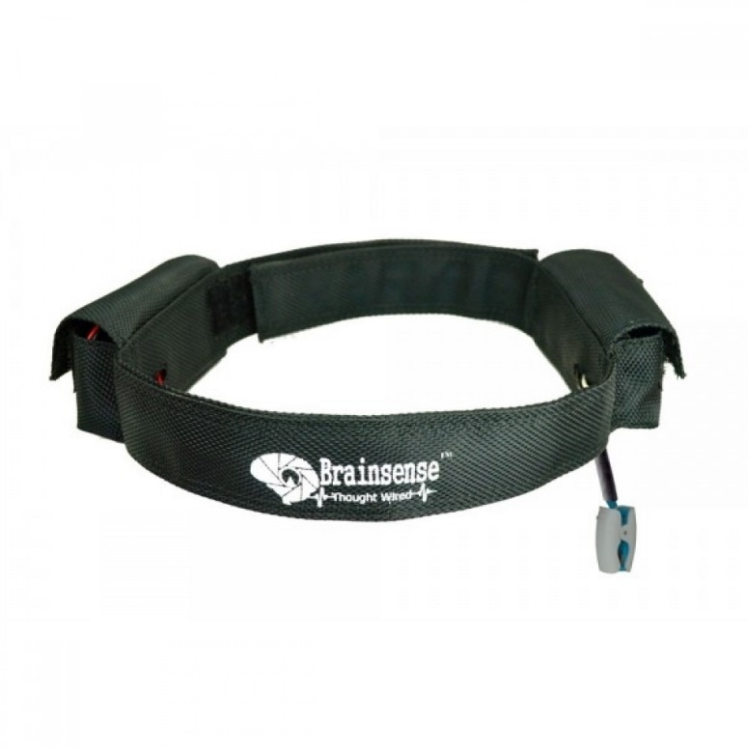
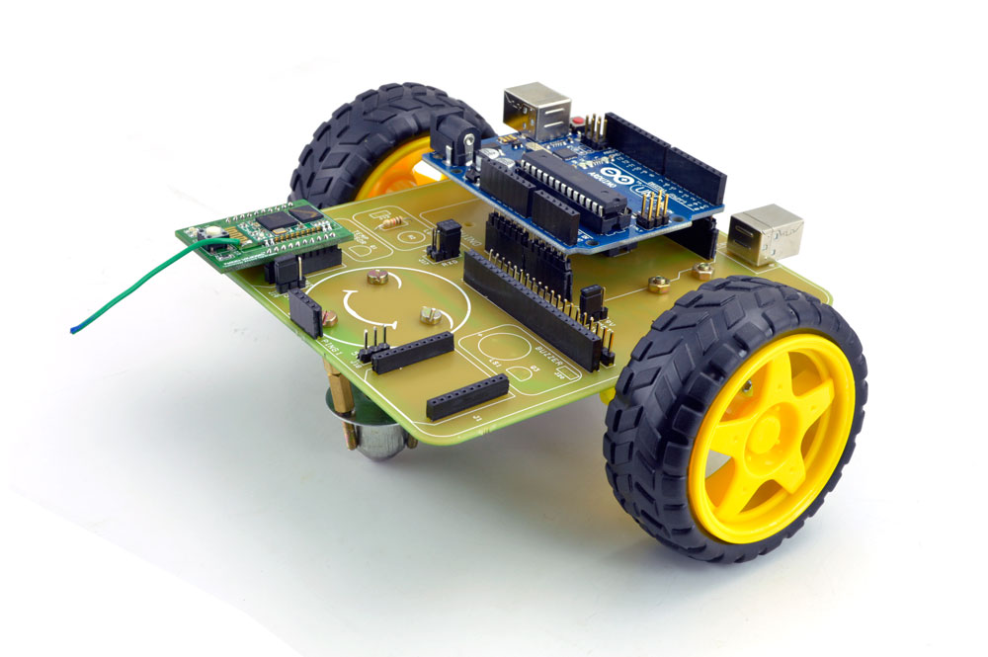
PHOTOS OF BCR

Slide 25
CONCLUSION
The project concludes into a functional Mind Controlled Wheelchair.
Right, Left, Forward and Stop commands given by the disabled person are deciphered by embedded algorithms and suitably executed.
By selecting suitable IC’s and circuit design, cost effectiveness of overall project is optimized.
The designed ‘Mind Controlled Wheelchair’ provides control of motion and direction of wheelchair by mind’s attention and meditation level and eye blinks.

Slide 26
FUTURE SCOPE
The present modal can be modified with adjustments such as lifting, slanting, balancing etc so it will be easy for disabled people to be placed on a resting platform and picked up from the platform without the help of others.
Alert sound system can be added to denote if there is any obstacle while turning on either directions.

Slide 27
REFERENCES
Tom Carlson, Member IEEE, and Jos´e del R. Mill´an, Senior Member IEEE, “Brain controlled wheelchairs: A robotic architecture” IEEE Robotics and Automation Magazine, 20(1):65-73, March 2013.
Siliveru Ramesh, M Gopi Krishna, “Brain Computer Interface System for Mind Controlled Robot using Bluetooth”, International Journal of Computer Applications (0975 – 8887) Volume 104 – No 15, October 2014.
Butt, A., Stanacevic, M.,“Implementation of Mind Control Robot” Systems, Applications and Technology Conference (LISAT), 2014 IEEE.
Imran Ali Mirza, Amiya Tripathy, “Mind-Controlled Wheelchair using an EEG Headset and Arduino Microcontroller”, 2015 International Conference on Technologies for Sustainable Development (ICTSD-2015), Feb. 04 – 06, 2015, Mumbai, India, 2015.
Anupama H.S, N.K.Cauvery, Lingaraju G.M, “Brain controlled wheelchair for disabled”, International journal of computer science engineering and information ISSUE technology”, Vol.4, 2, April 2014, pp-156-166.
Atanasios Vourvopoulos, Fotis Liarokapis, “Brain controlled NXT Robot: Teleoperating a robot through brain electrical activity”, IEEE conference on Games and virtual worlds for serious applications, Athens, Greece, 2011.

Slide 28
Naveen R.S, Anitha Julian, “ Brain computing interface for wheelchair control”, 4th ICCNT, 2013.
K. Sudheer, T.V.Jnarhana Rao, C.H.Sridevi, M.S.Madan Mohan, “ Voice and gesture based electric powered wheelchair using ARM”, International journal of research in computer and communication technology, vol.1, issue 6, November 2012 .
Mohan Kumar R, Lohit H.S, Manas Ranjan Mishra, Md Basheer Ahamed, “ Design of Multipurpose wheel chair for physically challenged elder people”, SASTECH, Vol.11, Issue 1, April 2012. Pp;107-117.
Jobby K.Chacko, Deepu OoMMEN, Kevin K.Mathew, Noble Sunny, N.Babu, “Microcontroller based EOG guided wheelchair”, International journal of Medical, Health, Biomedical, Bioengineering and Pharmaceutical Engineering, vol.7, no.11, 2013.
FRDM-KL25Z User’s manual.
Vijay Raghav Varada, Deepshikha Moolchadani, Asil Rohit, “ Measuring and processing the brain’s EEG signals with visual feedback for human machine interface”, International Journal of Scientifi c and Engineering Research , Vol.4, Issue 1, Jan., 2013.

Slide 29
THANK YOU

